Slide 1


DATA ANALYTICS AND REPORTING INNOVATIVE PROJECT
TOTAL GROUP MEMBERS : 2
1: NAME : SHUBHAM SRIVASTAVA -- ROLL NO : 202410101150004
2: NAME : ASHISH KUMAR KHARWAR -- ROLL NO : 202410101150006
COURSE : BTECH CSE (DS + AI )
SRMESTER : THIRD
GROUP : 31
TOPIC : GLOBAL ENERGY TRANSITION ANALYSIS (1990-2024)
Global Energy Transition Analysis
(1990–2024)
A comprehensive examination of three decades of energy transformation, tracking the global shift towards sustainable power sources and its environmental implications.
NEXT->

Slide 2
Research Tools & Methodology
This analysis leverages cutting-edge data science tools to process and visualise complex energy datasets spanning 34 years across multiple nations and continents.
Python
Pandas
Matplotlib
Primary programming language for data processing, statistical analysis, and automation of complex computational workflows.
Essential library for data manipulation, cleaning datasets, and performing sophisticated transformations on energy statistics.
Foundational visualisation library enabling creation of publication-quality charts, graphs, and custom visual representations.
Seaborn
Google Colab
Advanced statistical visualisation tool providing aesthetically refined graphics and complex correlation matrices.
Cloud-based development environment facilitating collaborative research, GPU acceleration, and seamless data accessibility.
NEXT->

Slide 3
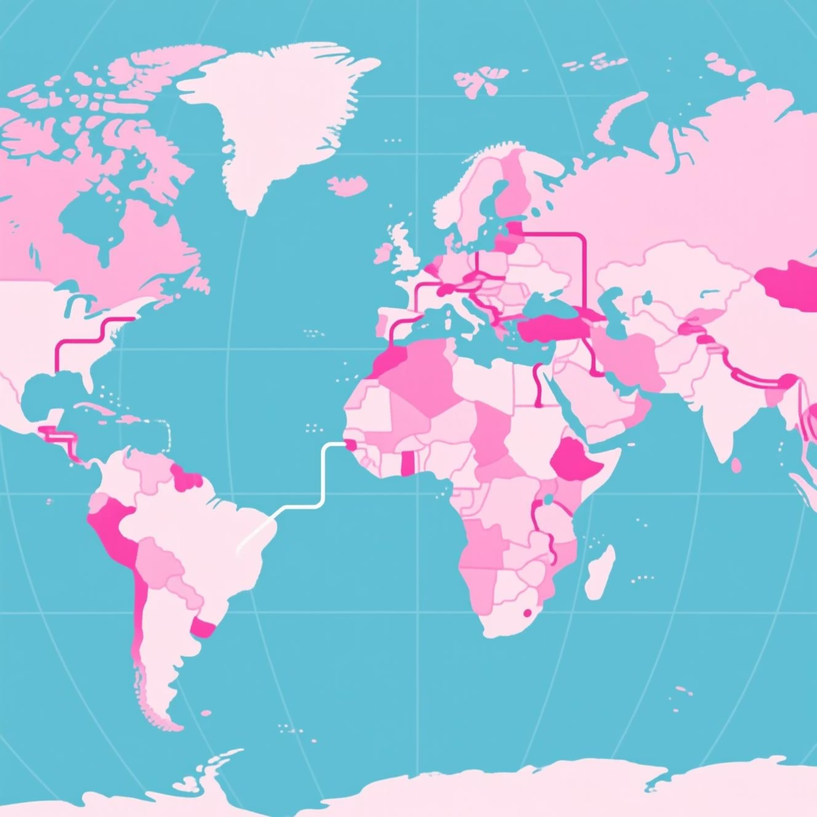
Project Outcomes & Deliverables
This comprehensive study delivers critical insights into the evolution of global energy systems over three transformative decades.
1: Global Energy Trends
Detailed mapping of energy consumption patterns, generation methods, and capacity expansion across 150+ countries from 1990 to 2024.
2: Renewable Energy Growth
Quantification of solar, wind, hydro, and other renewable sources' exponential expansion, including investment flows and capacity additions.
3: Fossil Fuel Trajectory
Analysis of coal, oil, and natural gas consumption decline in developed nations and transition dynamics in emerging economies.
4: CO₂ Emission Patterns
Correlation between energy source transitions and greenhouse gas reduction, identifying success stories and persistent challenges.
5: Regional Leadership
Identification of nations and continents pioneering sustainable energy adoption and those requiring accelerated transformation.
NEXT->

Slide 4
Strategic Benefits & Applications
The insights generated from this analysis provide actionable intelligence for multiple stakeholders committed to sustainable energy futures.
Policy Development Framework
Environmental Impact Assessment
Equips governmental bodies and international organisations with evidence-based insights to craft effective energy transition policies, set realistic renewable targets, and allocate resources efficiently towards decarbonisation goals.
Demonstrates clear correlations between renewable energy adoption and CO₂ emission reductions, providing quantifiable metrics for environmental impact and validating investment in clean energy infrastructure.
Regional Performance Benchmarking
Investment Intelligence
Identifies nations and regions lagging in energy transition, enabling targeted international cooperation, technology transfer initiatives, and financial support mechanisms to accelerate global decarbonisation efforts.
Supports sustainable energy decision-making for governments, corporations, and investors by highlighting growth trajectories, emerging markets, and sectors with highest potential for environmental and financial returns.
NEXT->

Slide 5






Visualisation Methodology
Comprehensive data representation techniques transform complex energy statistics into accessible, actionable intelligence.
Temporal Trend Analysis
Comparative Rankings
Portfolio Composition
Line charts tracking global energy production and consumption from 1990 to 2024, illustrating the dramatic shift from fossil fuels to renewables and highlighting inflection points in the energy transition.
Bar charts presenting top-performing countries and continents in renewable adoption, fossil fuel reduction, and total energy capacity, enabling direct performance comparisons across geographies.
Pie charts depicting the evolving balance between renewable and non-renewable energy sources globally and regionally, visualising market share transformations over the study period.
Correlation Mapping
Correlation Matrices
Scatter plots revealing relationships between renewable energy adoption rates and CO₂ emission reductions, establishing evidence-based connections between policy choices and environmental outcomes.
Heatmaps exposing complex interdependencies between energy sources, economic indicators, and environmental metrics, identifying hidden patterns in multi-dimensional datasets.
NEXT->

Slide 6
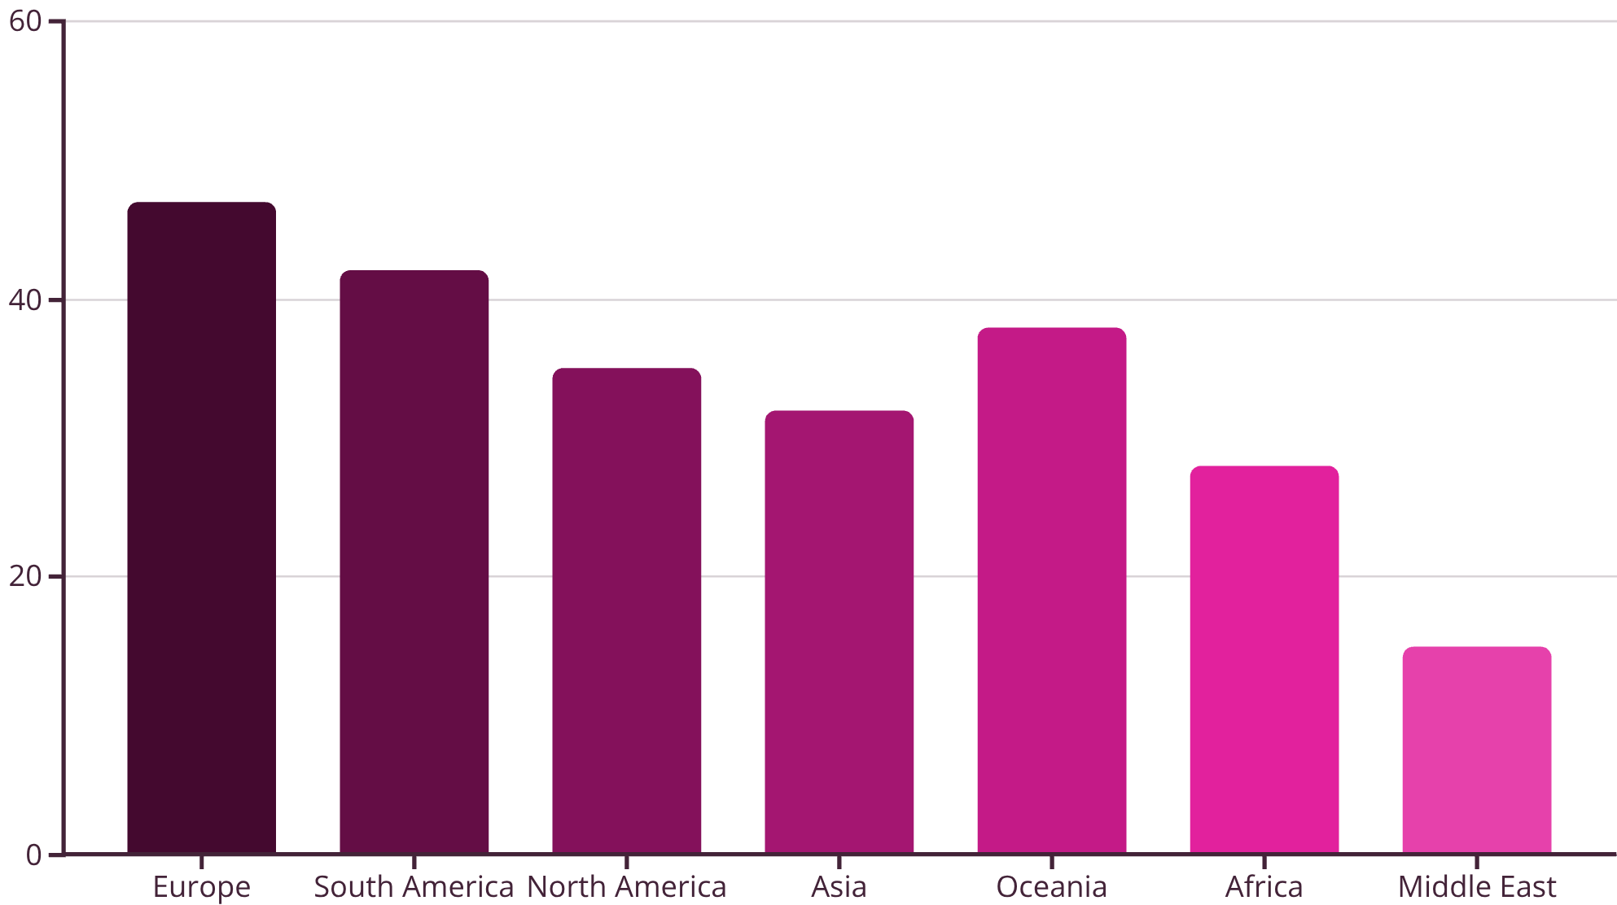
Regional Performance Comparison
Continental disparities reflect varying policy ambitions, resource endowments, and economic development stages.
Europe leads through aggressive decarbonisation targets and substantial green energy investments.
South America benefits from exceptional hydroelectric resources and emerging solar markets.
Middle East regions show nascent transition efforts, constrained by fossil fuel economic dependencies.
NEXT->

Slide 7



Environmental Impact Correlation
Empirical evidence establishes definitive connections between renewable energy adoption and carbon emission reductions across all analysed regions.
68%
89%
34%
CO₂ Reduction
Cost Decline
Global Growth
Average emission decrease in nations achieving 50%+ renewable energy penetration compared to 1990 baseline levels.
Reduction in solar photovoltaic system costs since 1990, enabling widespread accessibility and accelerated deployment globally.
Increase in worldwide renewable energy capacity over the past decade, representing unprecedented expansion momentum.
The data unequivocally demonstrates that strategic investment in renewable infrastructure delivers measurable environmental benefits whilst supporting economic development and energy security objectives.
NEXT->

Slide 8
Conclusion & Strategic Takeaways
Three decades of comprehensive analysis reveal an irreversible global transition towards cleaner, sustainable energy systems, though significant acceleration remains essential.
Decisive Momentum
Visual Evidence
The global energy landscape has fundamentally transformed. Renewable sources now constitute 38% of worldwide energy production, with trajectory modelling suggesting 55%+ penetration by 2035 under current policy frameworks and technological advancement rates.
Sophisticated data visualisations conclusively demonstrate renewable energy effectiveness in reducing carbon emissions whilst maintaining economic growth. Charts, correlations, and temporal analyses provide irrefutable evidence for policy justification and investment allocation.
Actionable Intelligence
Future Imperatives
Findings equip governments with benchmarking metrics, researchers with validated methodologies, and investors with risk-adjusted opportunity assessments. Regional performance gaps highlight cooperation opportunities and technology transfer priorities for international partnerships.
Continued investment in sustainable energy infrastructure remains critical. Analysis suggests doubling current renewable deployment rates achieves Paris Agreement targets, requiring coordinated policy action, innovative financing mechanisms, and sustained technological innovation across all sectors.
END

